Slide 1
MUSIC RECOMMENDATION SYSTEM
YUKTHA LAKSHMI
Notes:
EUNBI

Slide 2
Contents
INTRODUCTION
MODELING
EVALUATION
PROJECT DESCRIPTION
BACKGROUND
OBJECTIVES & QUESTIONS
DATA DESCRIPTION
DATA STRUCTURE
DATA EXPLORATION
ASSOCIATION RULES
DATA PREPROCESSING
DISCRETIZATION
ONE-HOT ENCODING
DATA MODELING
THE APRIORI ALGORITHM
EVALUATION
THE OPTIMIZED MEASURES AND BEST RESULTS
CLUSTERING & COSINE SIMILARITY
DATA PREPROCESSING
NORMALIZATION
DIMENSIONALITY REDUCTION
DATA MODELING
ELBOW & SILHOUETTE
K-MEAN
DBSCAN
HIERARCHICAL AGGLOMERATIVE
SPECTRAL
EVALUATION
AVG. SILHOUETTE
CALINSKI-HARABASZ
PRELIMINARY ANALYSIS
FINDINGS
ASSOCIATION RULE
CLUSTERING
FURTHER STUDIES
APPLICATIONS
IMPROVEMENTS (SUGGESTIONS FOR FURTHER STUDIES)

Slide 3
INTRODUCTION – PROJECT DESCRIPTION
BACKGROUND
Giant Companies in the music streaming industry (Spotify, Apple Music) have already developed their owns innovative ML-based techniques such as AI solution of recommend songs to users.
Expected Benefits from the AI solutions
Increase
user satisfaction
Increase
user engagement
in the service
Enormous profits against competitors
(The result of 1 and 2)

Slide 4
INTRODUCTION – PROJECT DESCRIPTION
OBJECTIVES
We will understand what the music recommendation system is, explore all possible machine learning models for building the system and solve the following business and technical questions.
Business and Technical Questions
Which model can be applied to create the music recommendation system?
How do the models recommend songs
to users?

Slide 5
INTRODUCTION – DATA DESCRIPTION
DATA STRUCTURE
The data set used in the project consists of song information (artist, title, released year) and 14 audio features* of a digital song from Spotify. All audio features are numeric values.
What are the audio features?
An abstract characteristic that represents digital music. (It means how the song sounds like.)
It is calculated from the audio signal. (IGI Global., n.d.)

Slide 6
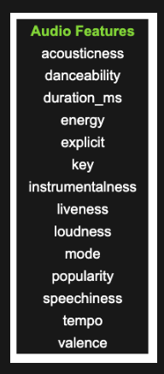
INTRODUCTION – DATA DESCRIPTION
AUDIO FEATURES
1. Acousticness: It describes how a song is acoustic in a numeric form. (Santos, 2017)
2. Danceability: It shows how much a track is danceable based on musical elements such as tempo, rhythm stability, beat strength, and overall regularity. (Santos, 2017)
3. Energy: It indicates how intense and active a song is. Its musical elements are fast, loud, and noisy. (Santos, 2017)
4. Instrumentalness: It describes the number of vocals in a song. (Santos, 2017)
5. Liveness: It represents the possibility that a song was recorded in a live environment. (Santos, 2017)
6. Speechiness: It is a degree of how many words are spoken words in a song. (Santos, 2017)
7. Valence: It shows the sentiment vibe of a song. The high valence means the song sounds more positive. (Santos, 2017)

Slide 7
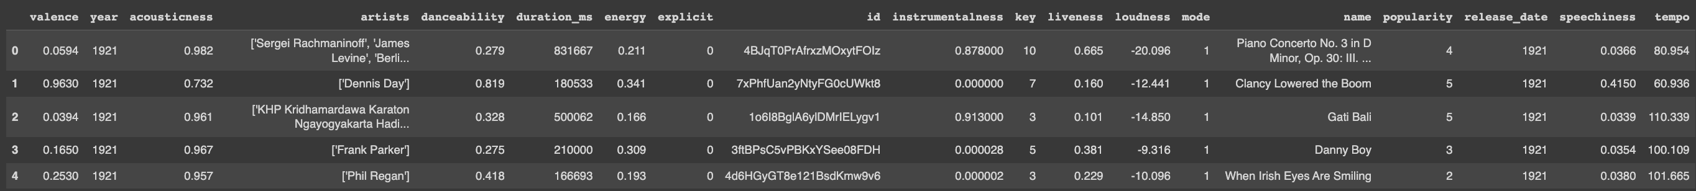
INTRODUCTION – DATA DESCRIPTION
DATA EXPLORATION
There are 170,653 songs in the data set, and most songs were released between 1950s and 2010s.
SAMPLE

Slide 8
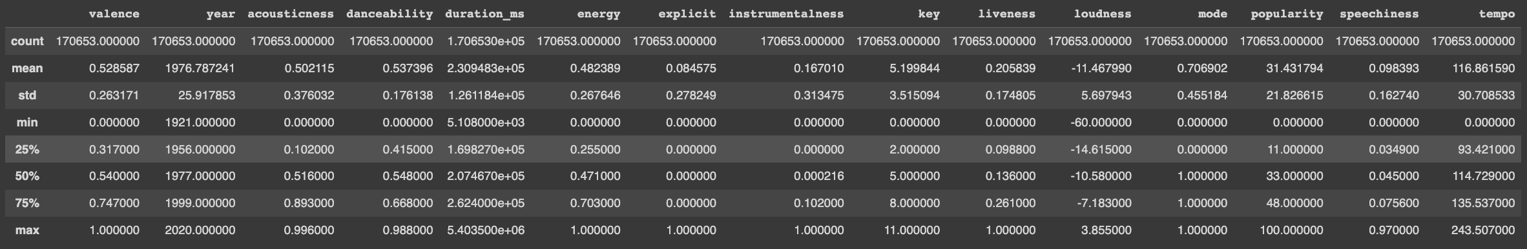
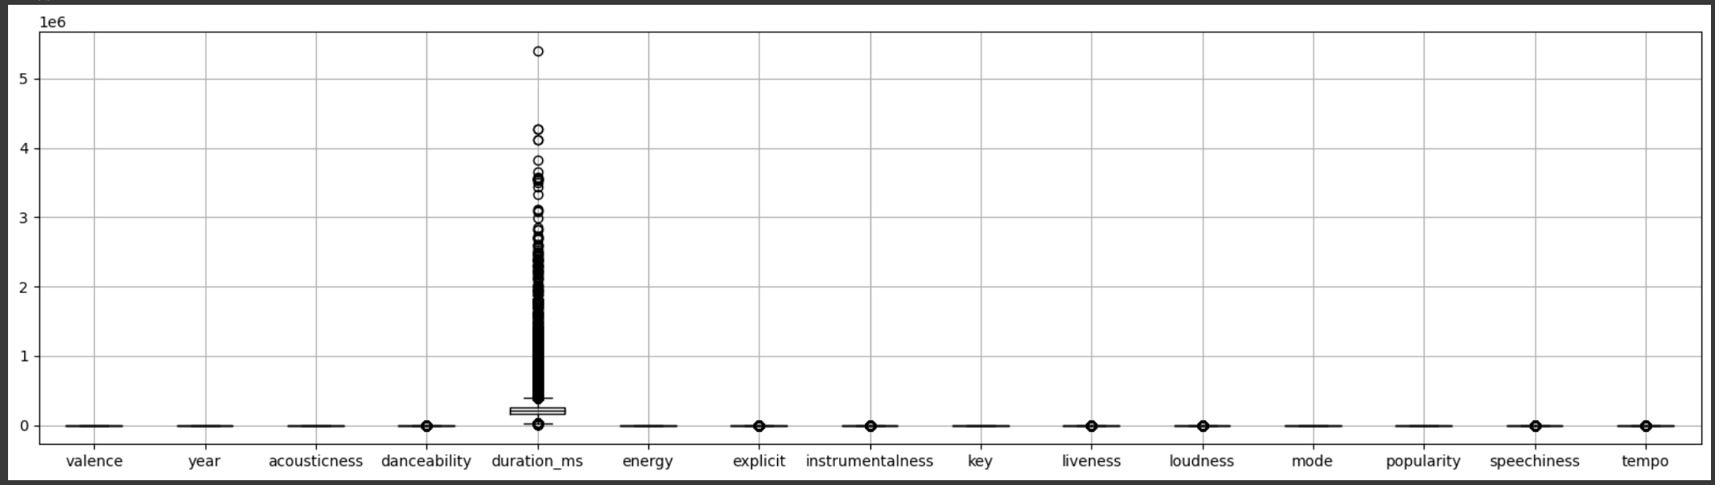
INTRODUCTION – DATA DESCRIPTION
DATA EXPLORATION
HANDLE OUTLIERS
The outliers may interfere with making a good performance of building an algorithm.
The numeric values in audio features are not on the same scale. (Deploy Normalization later)

Slide 9
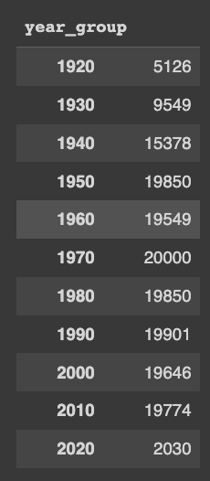
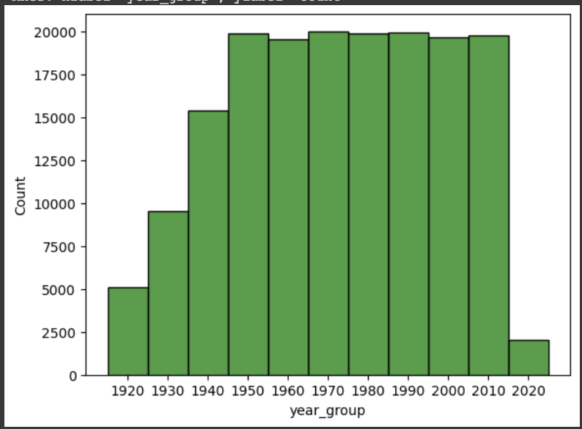
INTRODUCTION – DATA DESCRIPTION
DATA EXPLORATION
UNDERSTAND THE VALUES
1) How many artists are in the data set? There are 34,088 (unique) artists in the data set.
2) When were the songs released? Basically, the songs were released between 1921 to 2020.

Slide 10
MODELING – ASSOCIATION RULES
ASSOCIATION RULES
WHAT IS ASSOCATION RULES?
Discretize the audio features, using bins (high, medium, low) to reduce the number of unique values and make them manageable for AR model to handle.
IS ASSOCIATION RULE USED IN MUSIC RECOMMENDATION SYSTEMS?
Generally, it usually analyze the listening patterns of users and find associations between different songs or artists that are frequently listened to together.
> Using the audio features, it will find patterns or associations between different songs based on the preprocessed features.

Slide 11
MODELING – ASSOCIATION RULES
DATA PREPROCESSING
DISCRETIZATION
Discretize the audio features, using bins (high, medium, low) to reduce the number of unique values and make them manageable for AR model to handle.
Low
Medium
High
Percentile
0
33
66
100

Slide 12
MODELING – ASSOCIATION RULES
DATA PREPROCESSING
ONE-HOT ENCODING
Convert the discretized data into a binary format that is compatible with the AR Model
High
0
Medium
1
Low
2

Slide 13
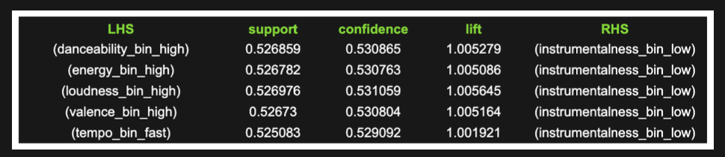
MODELING – ASSOCIATION RULES
DATA MODELING
THE APRIORI ALGORITHM
Run the apriori and association_rule functions with the pre-processed audio features to find the baseline.
The first five rules with the ‘support’ metric
min_support = 0.05, min_threshold = 0.5

Slide 14
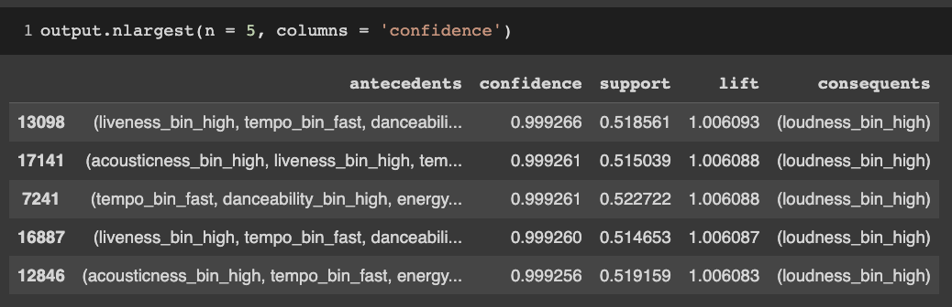
MODELING – ASSOCIATION RULES
EVALUATION
THE OPTIMIZED MEASURES AND BEST RULES
The goal is to identify strong association between features that appear frequently. (Tan, Steinbach, and Kumar (2006))
The best five rules sorting confidence values by descending

Slide 15
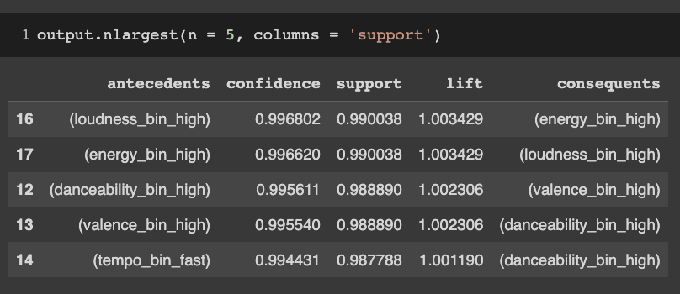
MODELING – ASSOCIATION RULES
EVALUATION
THE OPTIMIZED MEASURES AND BEST RULES
The goal is to identify strong association between features that appear frequently. (Tan, Steinbach, and Kumar (2006))
The best five rules sorting support values by descending

Slide 16
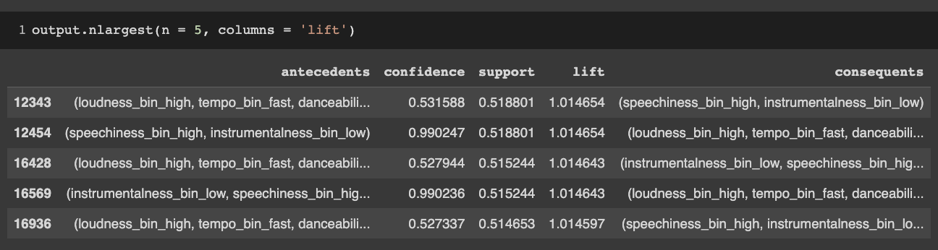
MODELING – ASSOCIATION RULES
EVALUATION
THE OPTIMIZED MEASURES AND BEST RULES
The goal is to identify strong association between features that appear frequently. (Tan, Steinbach, and Kumar (2006))
The best five rules sorting lift values by descending

Slide 17
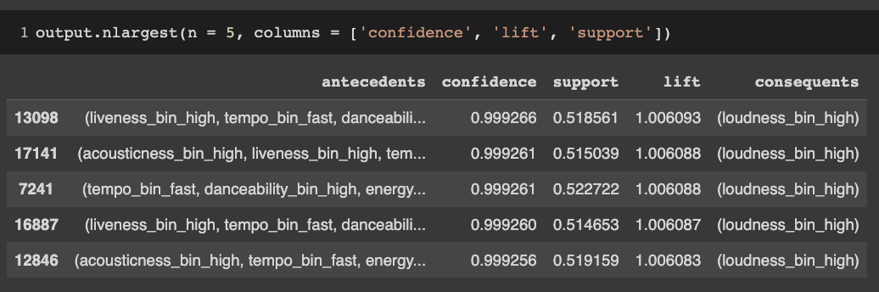
MODELING – ASSOCIATION RULES
EVALUATION
THE OPTIMIZED MEASURES AND BEST RULES
Based on our goal, sort the rules with the three measures (confidence, lift, and support) by descending order and print the best five rules.
The sequence of measures is important in the above code.
1. Confidence and lift indicate which item sets have the strongest association.
2. Support describes which item sets appear frequently in the data set.
Find the strongest rules (association) and then select the rules which appear frequently in the set.

Slide 18
MODELING – ASSOCIATION RULES
EVALUATION
THE OPTIMIZED MEASURES AND BEST RULES
Based on our goal, sort the rules with the three measures (confidence, lift, and support) by descending order and print the best five rules.
How can you interpret based on the following best rules?
Most audio features which indicate 'activity' are related to loudness.
(The results are different from the outputs in the poster, because we revised the parameters when we run the code.)

Slide 19
MODELING – CLUSTERING
APPROACHES
Perform data preprocessing and feature selection
Apply a clustering algorithm to group the songs into clusters based on the similarity of their feature vectors.
Determine the cluster of the user's preferred songs.
Perform data preprocessing and feature selection
Apply a clustering algorithm to group the songs into clusters based on the similarity of their feature vectors.
Determine the cluster of the user's preferred songs.
Use content-based filtering within the cluster to recommend songs that have similar genre or tempo to the user's preferred songs.
Perform data preprocessing and feature selection
Apply a clustering algorithm to group the songs into clusters based on the similarity of their feature vectors.
Determine the cluster of the user's preferred songs.
Once the songs are clustered, we will recommend songs to the user based on the most representative songs in each cluster that is the most popular song.
CLUSTERING
CLUSTERING WITH CONTENT-BASED FILTERING

Slide 20
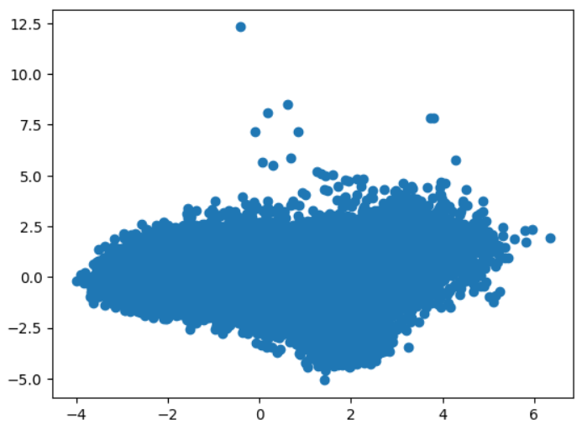
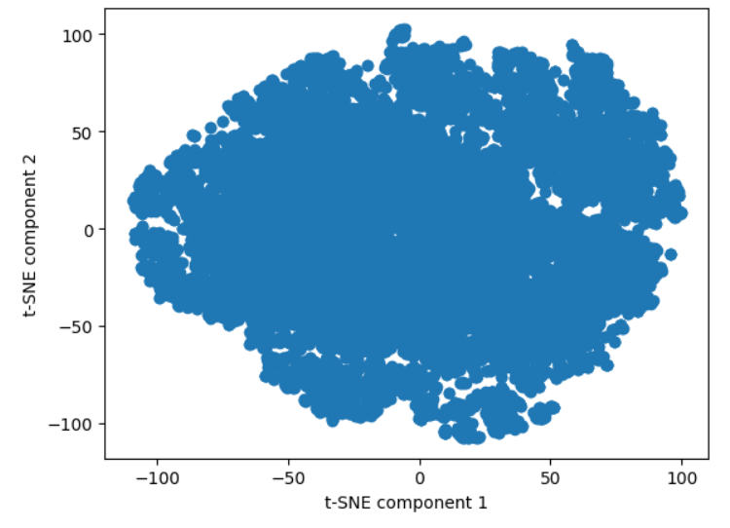
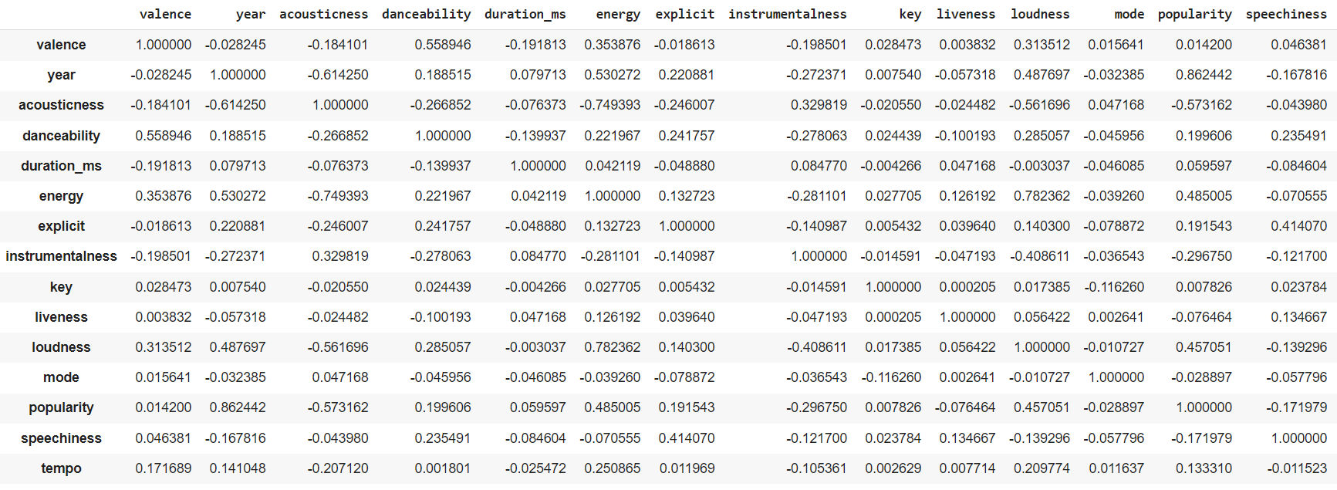
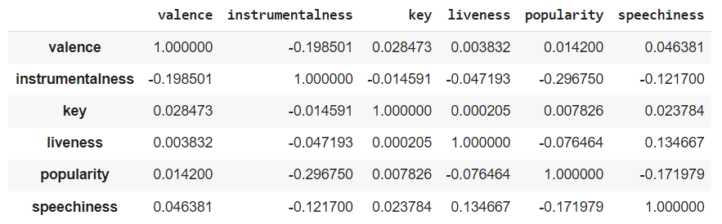
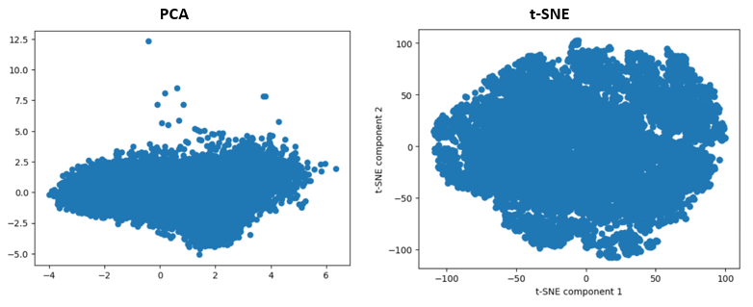
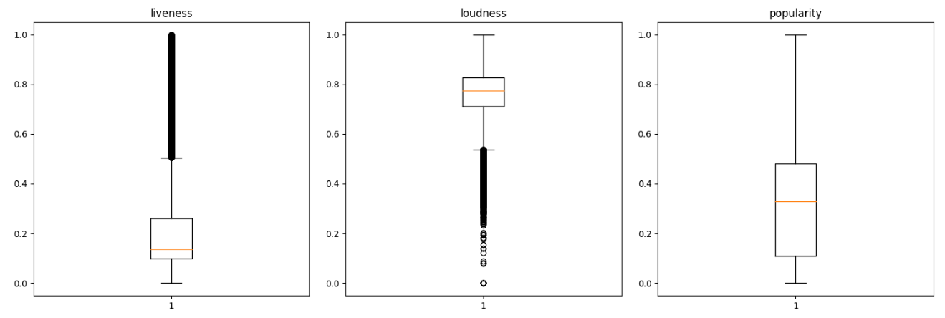
MODELING – CLUSTERING
DATA PREPROCESSING AND FEATURE SELECTION

Slide 21
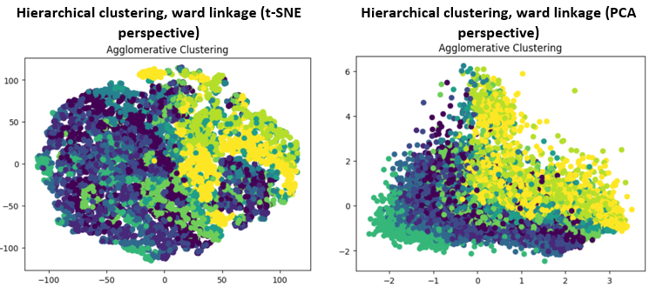
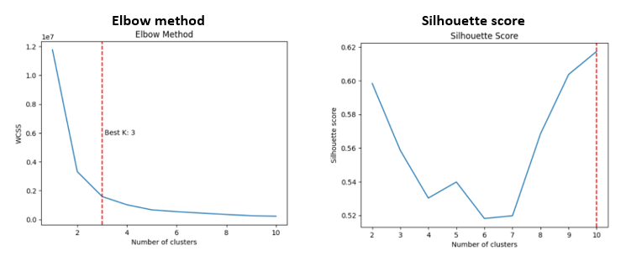
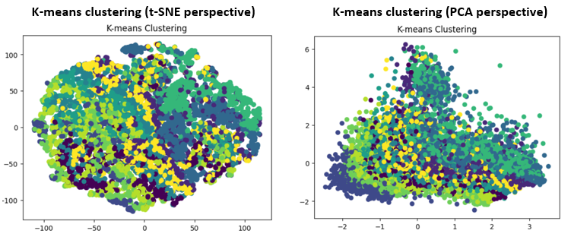
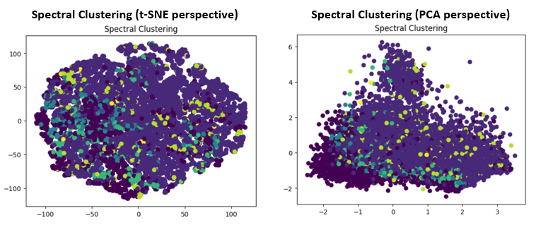
MODELING – CLUSTERING
MODEL TRAINING

Slide 22
MODELING – CLUSTERING
EVALUATION
Silhouette Score measures how well each data point fits into its assigned cluster, and how distinct it is from the other clusters.
The score ranges from [-1 to 1], where a score closer to 1 indicates that the data point is well-clustered and a score closer to -1 indicates that the data point may be assigned to the wrong cluster.
The Calinski-Harabasz Score measures the ratio of between-cluster variance to within-cluster variance. A higher score indicates that the clusters are well-separated and distinct from each other.
 | Silhouette Score | Calinski-Harabasz Score
K-means clustering | 0.378 | 55065.03
Agglomerative clustering | 0.327 | 47258.22
Spectral clustering | -0.345 | 1020.81

Slide 23
EVALUATION - PRELIMINARY ANALYSIS
FINDINGS
ASSOCIATION RULES
1. Baseline Metric = Support (Min = 0.05, Threshold = 0.5)
2. Final Metrics = Support (Min = 0.05, Threshold = 0.5) > Sorting the rules with the sequence of metrics (confidence, lift, and support by descending). 3. Most active* digital songs contains instrumental-based features in the frequent item sets.
CLUSTERING & COSINE SIMILARITY
1. Best Model: K-Means Clustering 2. It shows the highest performance of matching data points in the own clusters and better clustering results
* ACTIVE: DANCEABILITY, ENERGY, VALENCE,** LOUDNESS
** VALENCE: IT SHOWS THE SENTIMENT VIBE OF A SONG. THE HIGH VALENCE MEANS THE SONG SOUNDS MORE POSITIVE. (SANTOS, 2017)

Slide 24
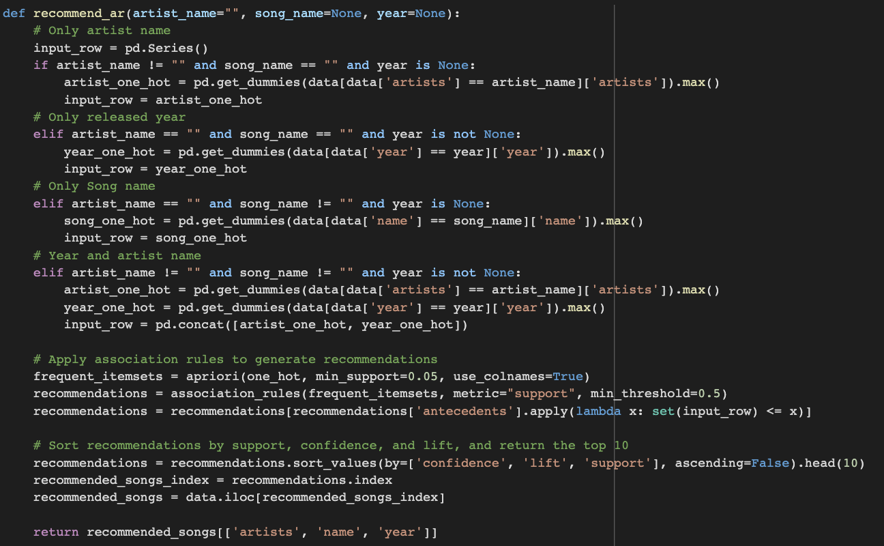
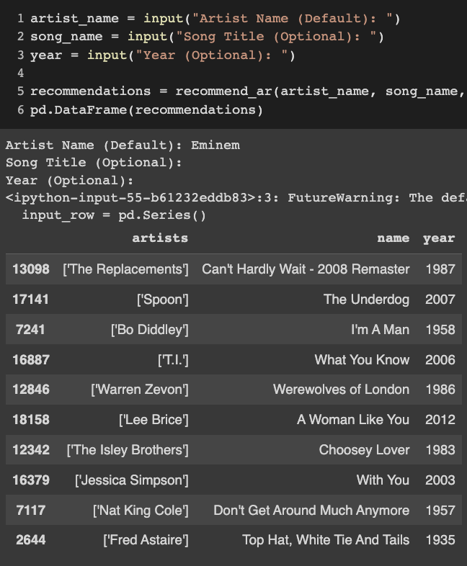
EVALUATION - PRELIMINARY ANALYSIS
FURTHER STUDIES
APPLICATIONS
Define the function to recommend songs based on the association rule model with the input parameter.

Slide 25
EVALUATION - PRELIMINARY ANALYSIS
FURTHER STUDIES
APPLICATIONS
Define the function to recommend songs based on the clustering & cosine similarity with the input parameter.

Slide 26
EVALUATION - PRELIMINARY ANALYSIS
FINDINGS
FURTHER STUDIES FOR IMPROVEMENTS
WHAT ELSE CAN WE DO FOR IMPROVEMENT?
To evaluate and improve the music recommendation system, we also need user data sets (personal information or listening history) to conduct the reinforcement learning for ranking the recommended songs and presenting the best.

